Slide 1
Linear Algebra Refresher
CS771: Introduction to Machine Learning
Purushottam Kar

Slide 2
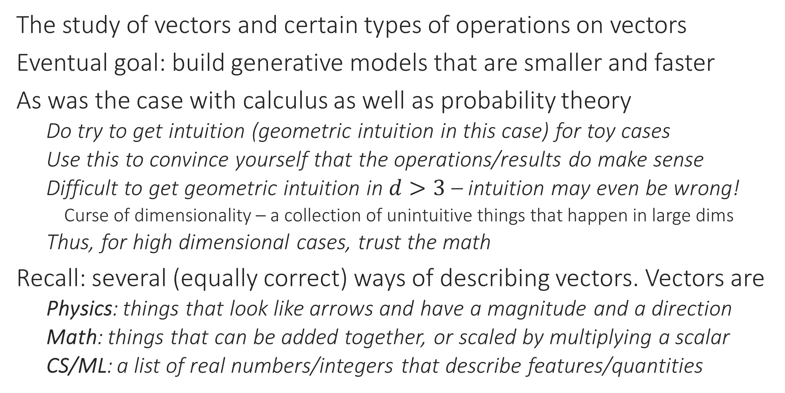
Linear Algebra
The study of vectors and certain types of operations on vectors
Eventual goal: build generative models that are smaller and faster
As was the case with calculus as well as probability theory
Do try to get intuition (geometric intuition in this case) for toy cases
Use this to convince yourself that the operations/results do make sense
Difficult to get geometric intuition in $d>3$ – intuition may even be wrong!
Curse of dimensionality – a collection of unintuitive things that happen in large dims
Thus, for high dimensional cases, trust the math
Recall: several (equally correct) ways of describing vectors. Vectors are
Physics: things that look like arrows and have a magnitude and a direction
Math: things that can be added together, or scaled by multiplying a scalar
CS/ML: a list of real numbers/integers that describe features/quantities

Slide 3


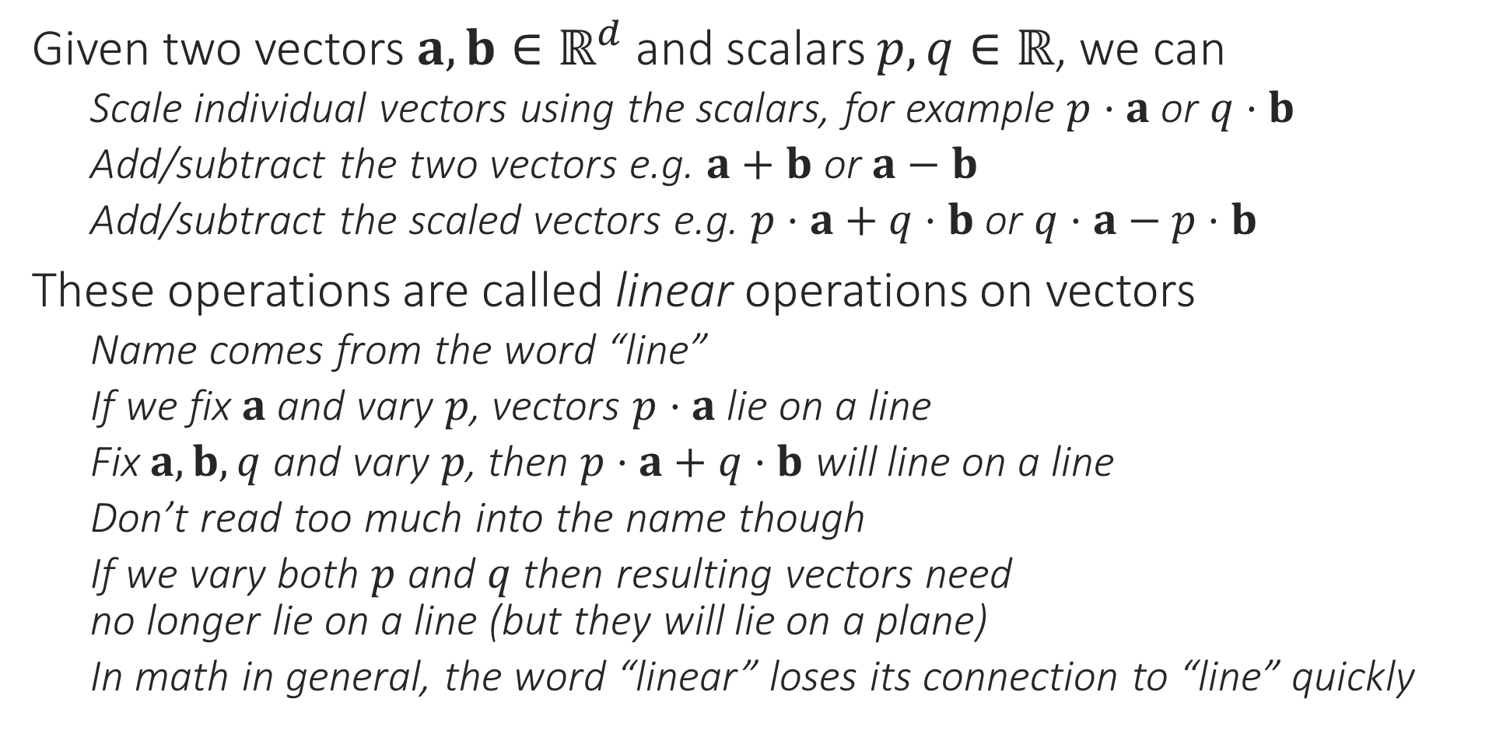



Linear Combinations of Vectors
Given two vectors $a,b∈ℝ^{d}$ and scalars $p,q∈ℝ$, we can
Scale individual vectors using the scalars, for example $p⋅a$ or $q⋅b$
Add/subtract the two vectors e.g. $a+b$ or $a−b$
Add/subtract the scaled vectors e.g. $p⋅a+q⋅b$ or $q⋅a−p⋅b$
These operations are called linear operations on vectors
Name comes from the word “line”
If we fix $a$ and vary $p$, vectors $p⋅a$ lie on a line
Fix $a,b,q$ and vary $p$, then $p⋅a+q⋅b$ will line on a line
Don’t read too much into the name though
If we vary both $p$ and $q$ then resulting vectors need no longer lie on a line (but they will lie on a plane)
In math in general, the word “linear” loses its connection to “line” quickly
$$p⋅a+q⋅b$$
$$q⋅b$$
$$b$$
$p⋅a$
$$a$$

Slide 4


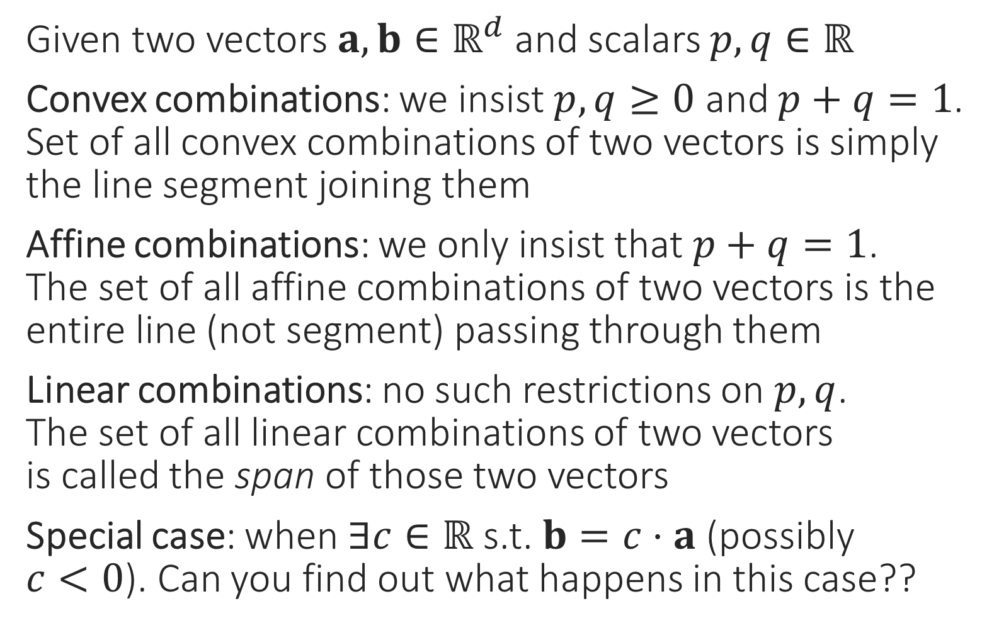
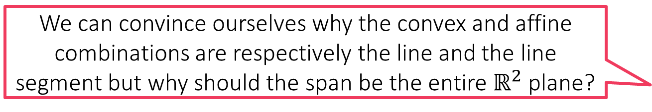
Special kinds of linear combinations
We can convince ourselves why the convex and affine combinations are respectively the line and the line segment but why should the span be the entire $ℝ^{2}$ plane?
Given two vectors $a,b∈ℝ^{d}$ and scalars $p,q∈ℝ$
Convex combinations: we insist $p,q≥0$ and $p+q=1$. Set of all convex combinations of two vectors is simply the line segment joining them
Affine combinations: we only insist that $p+q=1$. The set of all affine combinations of two vectors is the entire line (not segment) passing through them
Linear combinations: no such restrictions on $p,q$. The set of all linear combinations of two vectors is called the span of those two vectors
Special case: when $∃c∈ℝ$ s.t. $b=c⋅a$ (possibly $c<0$). Can you find out what happens in this case??
Let us study these in more detail to find out
What if we have more than two points. How are these defined then?
$$b$$
$$a$$

Slide 5

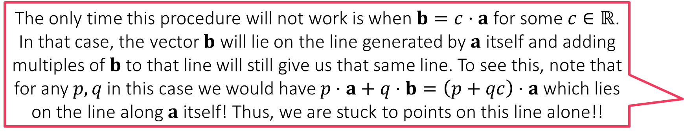
Span of Vectors
The only time this procedure will not work is when $b=c⋅a$ for some $c∈ℝ$. In that case, the vector $b$ will lie on the line generated by $a$ itself and adding multiples of $b$ to that line will still give us that same line. To see this, note that for any $p,q$ in this case we would have $p⋅a+q⋅b=\left(p+qc\right)⋅a$ which lies on the line along $a$ itself! Thus, we are stuck to points on this line alone!!
Span of $a,b$: the set of all vectors that can be obtained by scaling the two vectors using (possibly negative) scalars $p,q$ and adding them
Trick: First set $q=0$ and see what happens when we vary only $p$
$p⋅a$ for all values of $p$ gives us all vectors on the line along $a$
Now let see add $b$ and see the set of possible vectors of the form $p⋅a+b$
This means that the set of all vectors of the form $p⋅a+q⋅b$ where $q$ is varied as well can be got simply by sweeping this line
We can convince ourselves that every point in $ℝ^{2}$ can be reached this way which is why span is $ℝ^{2}$
$$b$$
$$a$$

Slide 6

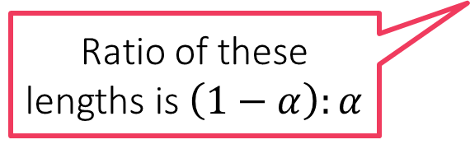


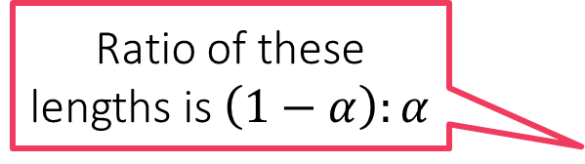
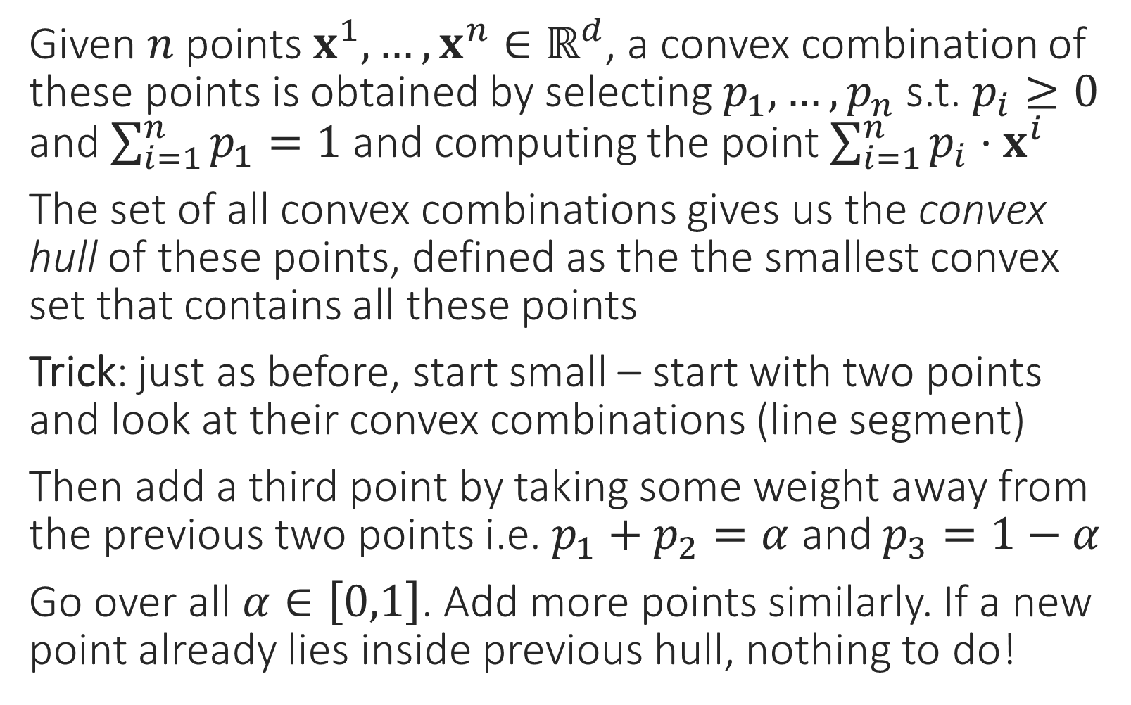






Combinations of More than 2 Vectors
It does not matter in which order do you consider the points. Eventually you will land up with the same convex hull. This claim requires a proof which is beyond the scope of CS771
Given $n$ points $x^{1},…,x^{n}∈ℝ^{d}$, a convex combination of these points is obtained by selecting $p_{1},…,p_{n}$ s.t. $p_{i}≥0$ and $\sum_{i=1}^{n}{p_{1}}=1$ and computing the point $\sum_{i=1}^{n}{p_{i}⋅x^{i}}$
The set of all convex combinations gives us the convex hull of these points, defined as the the smallest convex set that contains all these points
Trick: just as before, start small – start with two points and look at their convex combinations (line segment)
Then add a third point by taking some weight away from the previous two points i.e. $p_{1}+p_{2}=α$ and $p_{3}=1−α$
Go over all $α∈\left[0,1\right]$. Add more points similarly. If a new point already lies inside previous hull, nothing to do!
Ratio of these lengths is $\left(1−α\right):α$
$$1−α$$
$$1−α$$
$$α$$
$$1−α$$
$$1−α$$
$$α$$
$$α$$
$$1−α$$
$$α$$
Ratio of these lengths is $\left(1−α\right):α$
$$α$$

Slide 7

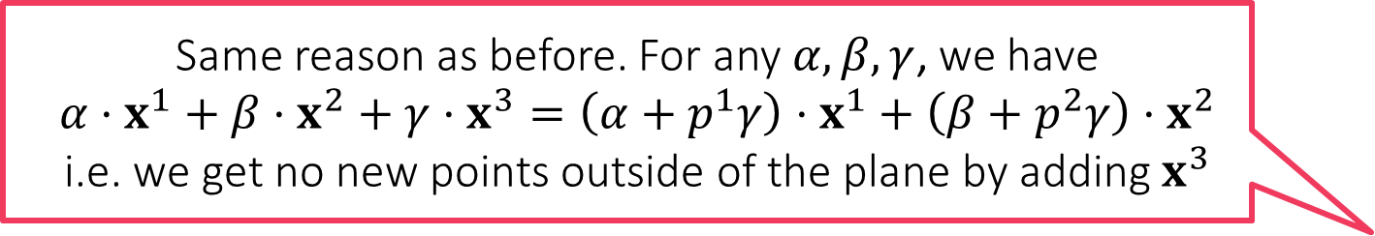

Span of More than Two Vectors
Same reason as before. For any $α,β,γ$, we have $$α⋅x^{1}+β⋅x^{2}+γ⋅x^{3}=\left(α+p^{1}γ\right)⋅x^{1}+\left(β+p^{2}γ\right)⋅x^{2}$$ i.e. we get no new points outside of the plane by adding $x^{3}$
Let us consider three vectors in 3 dimensions
With two vectors (not multiples of each other), we already saw that entire $ℝ^{2}$ is covered so adding more vectors in 2 dims is not interesting anymore
Trick: start with span of one vector $x^{1}$: a line
Add a new vector $x^{2}$: causes the line to move about and become a plane (flat sheet in 3D)
Add a new vector $x^{3}$: causes the sheet to move about and cover entire $ℝ^{3}$
If $x^{3}$ had been expressible as a comb of the previous 2 vectors i.e. $x^{3}=p^{1}⋅x^{1}+p^{2}⋅x^{2}$ for some $p^{1},p^{2}$, then would not cover $ℝ^{3}$
Yet again, it does not matter in which order do you consider the points. Eventually you will land up with the same span. This claim requires a proof which is beyond the scope of CS771
Affine combinations of more than two vectors can also produce planes/hyperplanes. We will not require affine combinations much in our discussions so we are not going into details of those here

Slide 8
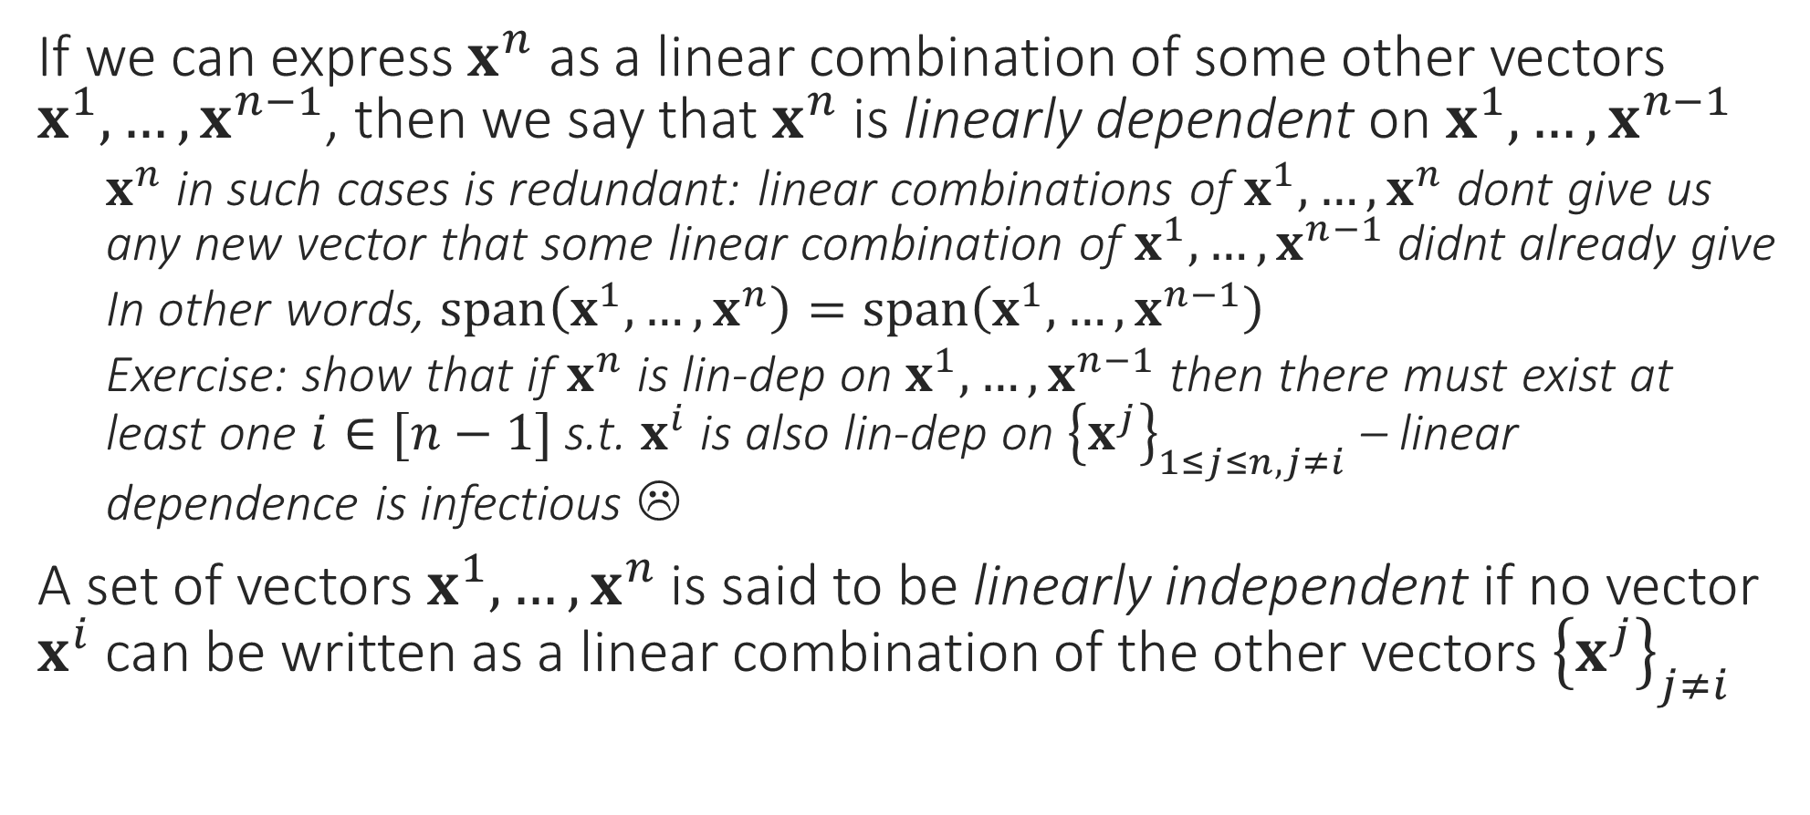
Dependence and Independence
If we can express $x^{n}$ as a linear combination of some other vectors $x^{1},…,x^{n−1}$, then we say that $x^{n}$ is linearly dependent on $x^{1},…,x^{n−1}$
$x^{n}$ in such cases is redundant: linear combinations of $x^{1},…,x^{n}$ dont give us any new vector that some linear combination of $x^{1},…,x^{n−1}$ didnt already give
In other words, $span\left(x^{1},…,x^{n}\right)=span\left(x^{1},…,x^{n−1}\right)$
Exercise: show that if $x^{n}$ is lin-dep on $x^{1},…,x^{n−1}$ then there must exist at least one $i∈[n−1]$ s.t. $x^{i}$ is also lin-dep on ${\left\{x^{j}\right\}}_{1≤j≤n,j≠i}$ – linear dependence is infectious ☹
A set of vectors $x^{1},…,x^{n}$ is said to be linearly independent if no vector $x^{i}$ can be written as a linear combination of the other vectors ${\left\{x^{j}\right\}}_{j≠i}$

Slide 9
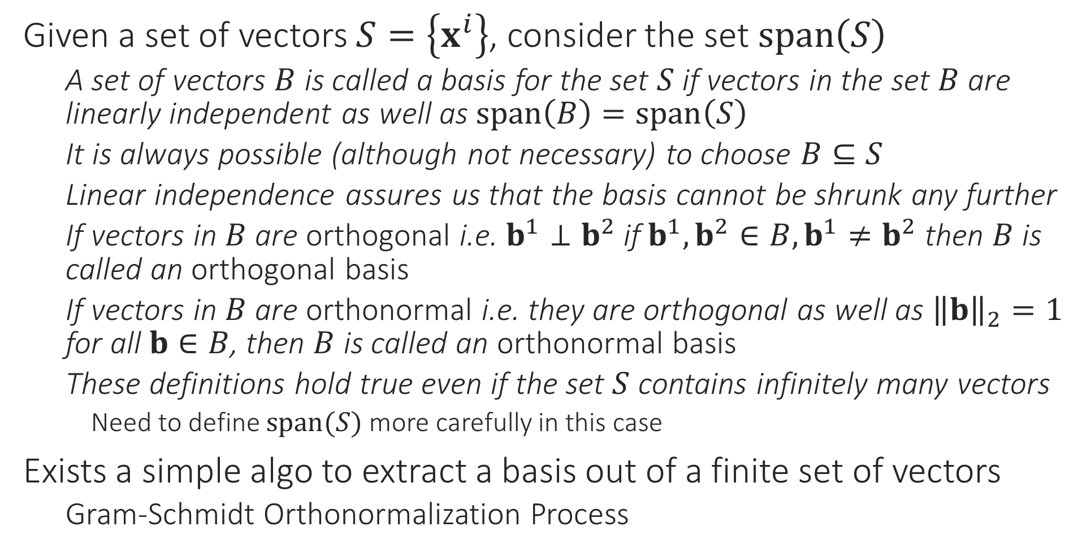
Basis
Given a set of vectors $S=\left\{x^{i}\right\}$, consider the set $span\left(S\right)$
A set of vectors $B$ is called a basis for the set $S$ if vectors in the set $B$ are linearly independent as well as $span\left(B\right)=span\left(S\right)$
It is always possible (although not necessary) to choose $B⊆S$
Linear independence assures us that the basis cannot be shrunk any further
If vectors in $B$ are orthogonal i.e. $b^{1}⊥b^{2}$ if $b^{1},b^{2}∈B, b^{1}≠b^{2}$ then $B$ is called an orthogonal basis
If vectors in $B$ are orthonormal i.e. they are orthogonal as well as ${\left\|b\right\|}_{2}=1$ for all $b∈B$, then $B$ is called an orthonormal basis
These definitions hold true even if the set $S$ contains infinitely many vectors
Need to define $span(S)$ more carefully in this case
Exists a simple algo to extract a basis out of a finite set of vectors
Gram-Schmidt Orthonormalization Process

Slide 10
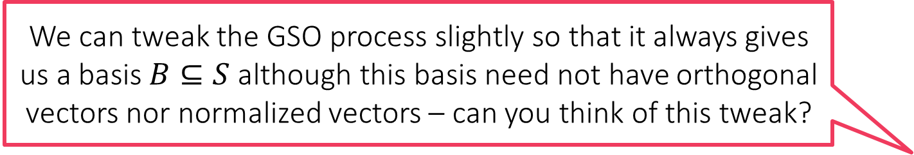
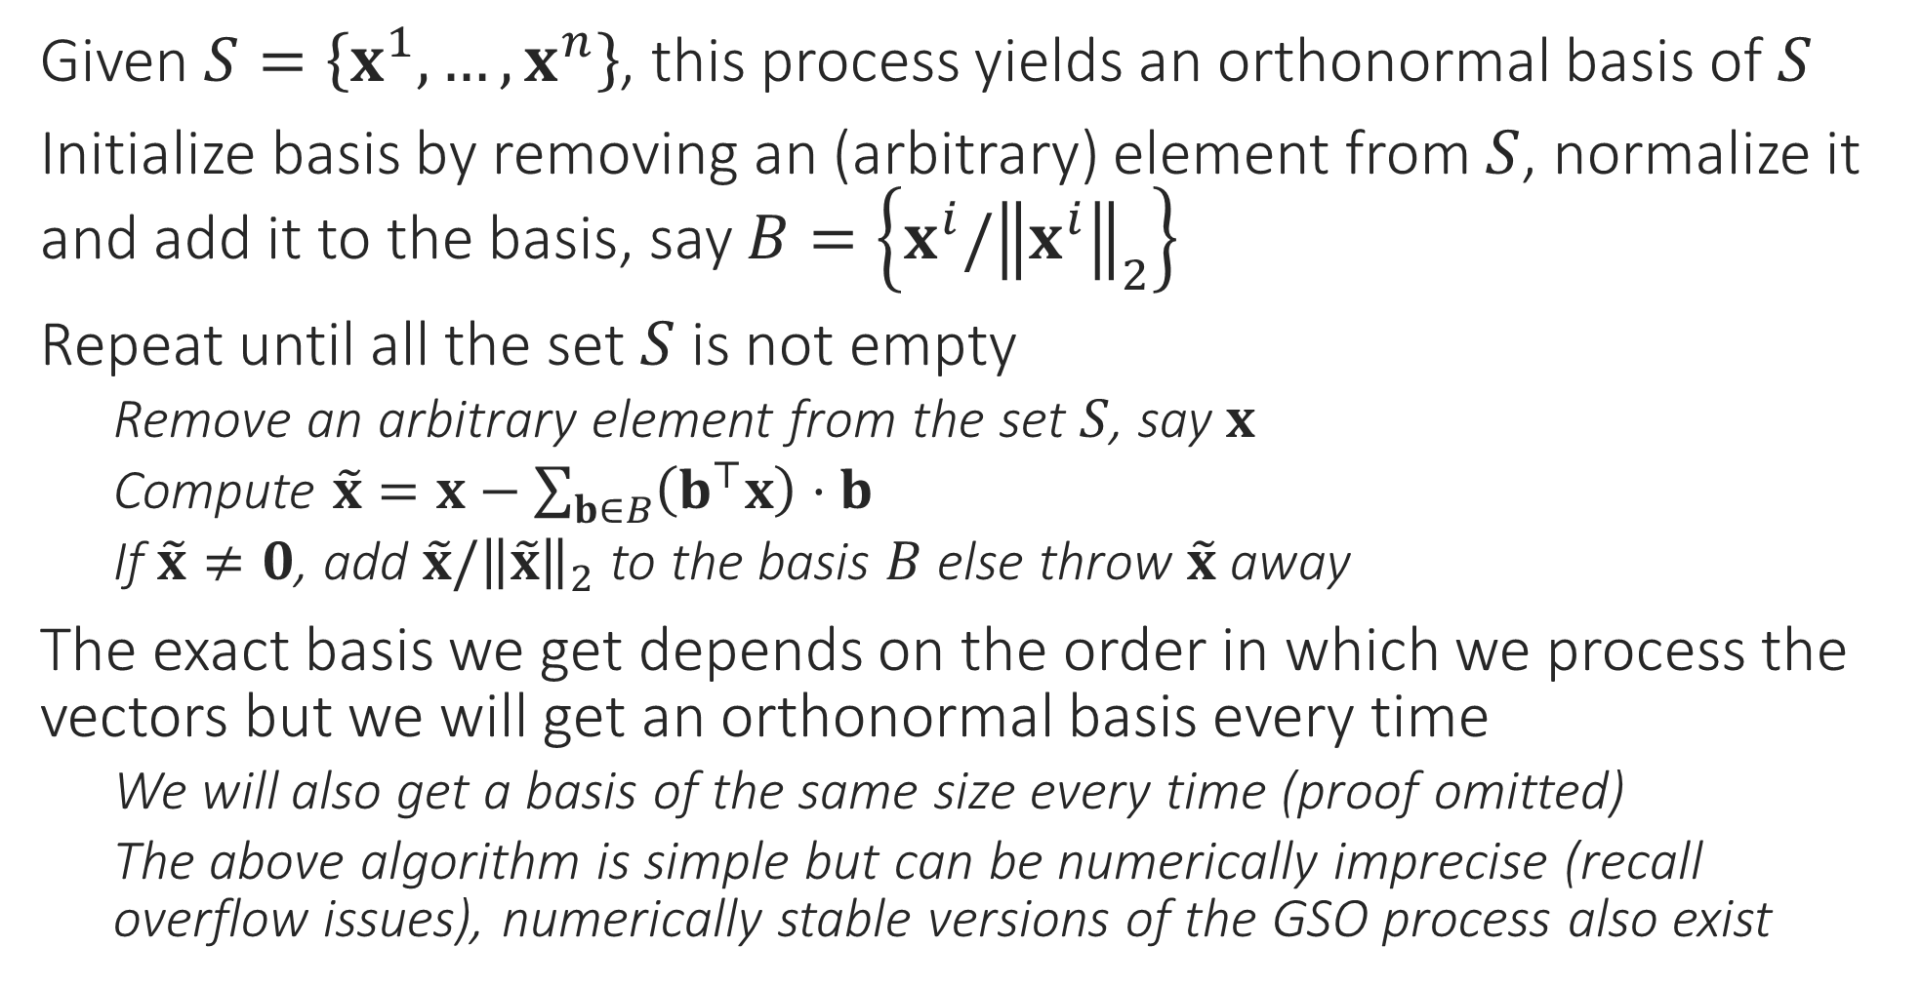
Gram-Schmidt Orthonormalization Process
We can tweak the GSO process slightly so that it always gives us a basis $B⊆S$ although this basis need not have orthogonal vectors nor normalized vectors – can you think of this tweak?
Given $S=\left\{x^{1},…,x^{n}\right\}$, this process yields an orthonormal basis of $S$
Initialize basis by removing an (arbitrary) element from $S$, normalize it and add it to the basis, say $B=\left\{x^{i}/{\left\|x^{i}\right\|}_{2}\right\}$
Repeat until all the set $S$ is not empty
Remove an arbitrary element from the set $S$, say $x$
Compute $\tilde{x}=x−\sum_{b∈B}{\left(b^{⊤}x\right)}⋅b$
If $\tilde{x}≠0$, add $\tilde{x}/{\left\|\tilde{x}\right\|}_{2}$ to the basis $B$ else throw $\tilde{x}$ away
The exact basis we get depends on the order in which we process the vectors but we will get an orthonormal basis every time
We will also get a basis of the same size every time (proof omitted)
The above algorithm is simple but can be numerically imprecise (recall overflow issues), numerically stable versions of the GSO process also exist

Slide 11


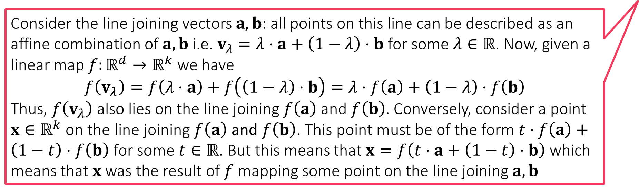
Linear Maps/Transformations
These map vectors to other vectors, but in a way that preserve lines
The mapped vectors may have the same/smaller/larger dimensionality
If a bunch of vectors were lying on a line earlier (any line), the mapped vectors would also lie on a (possibly different line)
Linear transformations always map the origin to the origin itself. If a map preserves all lines but shifts the origin – called an affine transformation instead
Mathematically, function $f:ℝ^{d}→ℝ^{k}$ is a linear map/transformation if
$f\left(x+y\right)=f\left(x\right)+f(y)$ for any pair of two vectors $x,y∈ℝ^{d}$
Note: The vectors $f\left(x+y\right),f\left(x\right),f(y)$ are all $k$-dimensional, not $d$-dimensional
The emphasis on the word any is important. It wont do if this holds only for some pairs
$f\left(c⋅x\right)=c⋅f\left(x\right)$ for any $c∈ℝ$ and any $x∈ℝ^{d}$
Note: taking $c=0$ shows us that $f\left(0\right)=0$ where $0∈ℝ^{d}$ and $0∈ℝ^{k}$
Consider the line joining vectors $a,b$: all points on this line can be described as an affine combination of $a,b$ i.e. $v_{λ}=λ⋅a+\left(1−λ\right)⋅b$ for some $λ∈ℝ$. Now, given a linear map $f:ℝ^{d}→ℝ^{k}$ we have $$f\left(v_{λ}\right)=f\left(λ⋅a\right)+f\left(\left(1−λ\right)⋅b\right)=λ⋅f\left(a\right)+\left(1−λ\right)⋅f\left(b\right)$$
Thus, $f\left(v_{λ}\right)$ also lies on the line joining $f\left(a\right)$ and $f\left(b\right)$. Conversely, consider a point $x∈ℝ^{k}$ on the line joining $f\left(a\right)$ and $f\left(b\right)$. This point must be of the form $t⋅f\left(a\right)+\left(1−t\right)⋅f\left(b\right)$ for some $t∈ℝ$. But this means that $x=f\left(t⋅a+\left(1−t\right)⋅b\right)$ which means that $x$ was the result of $f$ mapping some point on the line joining $a,b$

Slide 12
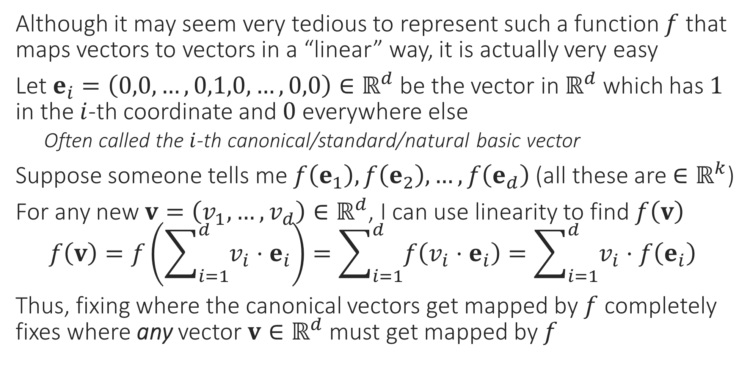
Encoding Linear Transformations
Although it may seem very tedious to represent such a function $f$ that maps vectors to vectors in a “linear” way, it is actually very easy
Let $e_{i}=\left(0,0,…,0,1,0,…,0,0\right)∈ℝ^{d}$ be the vector in $ℝ^{d}$ which has $1$ in the $i$-th coordinate and $0$ everywhere else
Often called the $i$-th canonical/standard/natural basic vector
Suppose someone tells me $f\left(e_{1}\right),f\left(e_{2}\right),…,f\left(e_{d}\right)$ (all these are $∈ℝ^{k}$)
For any new $v=\left(v_{1},…,v_{d}\right)∈ℝ^{d}$, I can use linearity to find $f\left(v\right)$ $f\left(v\right)=f\left(\sum_{i=1}^{d}{v_{i}⋅e_{i}}\right)=\sum_{i=1}^{d}{f\left(v_{i}⋅e_{i}\right)}=\sum_{i=1}^{d}{v_{i}⋅f\left(e_{i}\right)}$
Thus, fixing where the canonical vectors get mapped by $f$ completely fixes where any vector $v∈ℝ^{d}$ must get mapped by $f$

Slide 13

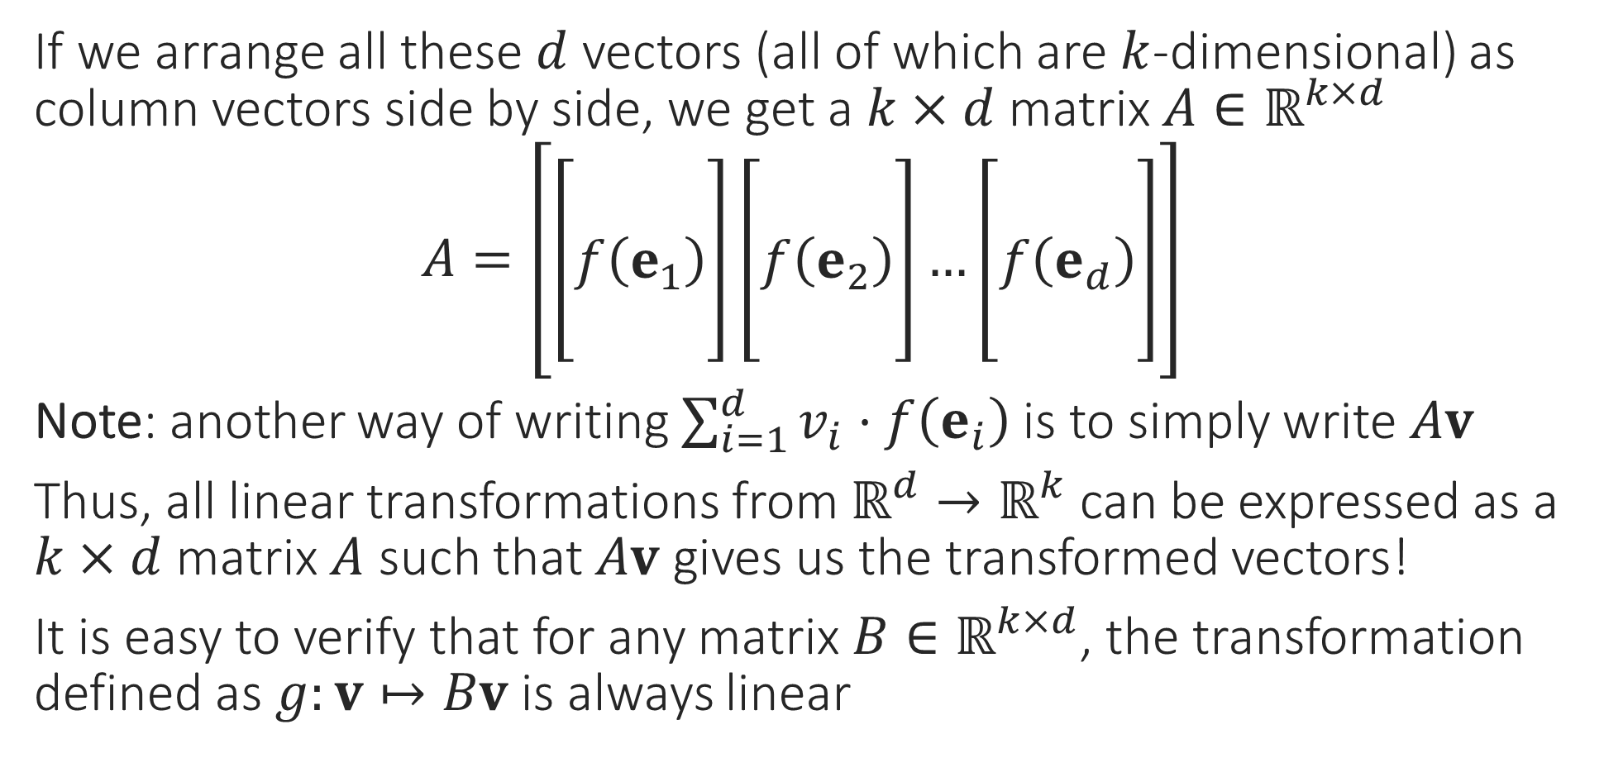
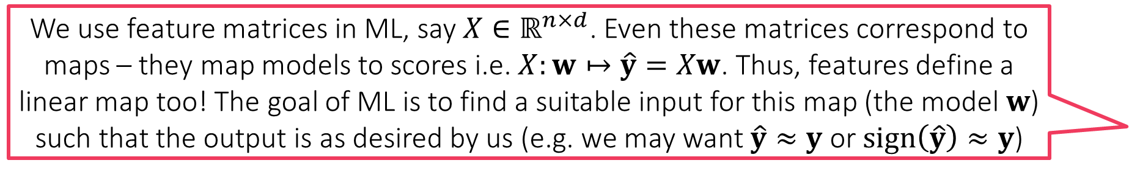
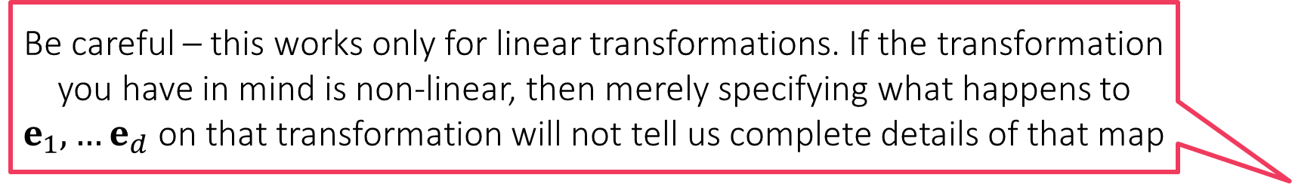
Matrices ARE Linear Transformations!
Be careful – this works only for linear transformations. If the transformation you have in mind is non-linear, then merely specifying what happens to $e_{1},…e_{d}$ on that transformation will not tell us complete details of that map
If we arrange all these $d$ vectors (all of which are $k$-dimensional) as column vectors side by side, we get a $k×d$ matrix $A∈ℝ^{k×d}$
$A=\left[\left[\begin{aligned} \\ f\left(e_{1}\right) \\ \end{aligned}\right]\left[\begin{aligned} \\ f\left(e_{2}\right) \\ \end{aligned}\right]…\left[\begin{aligned} \\ f\left(e_{d}\right) \\ \end{aligned}\right]\right]$
Note: another way of writing $\sum_{i=1}^{d}{v_{i}⋅f\left(e_{i}\right)}$ is to simply write $Av$
Thus, all linear transformations from $ℝ^{d}→ℝ^{k}$ can be expressed as a $k×d$ matrix $A$ such that $Av$ gives us the transformed vectors!
It is easy to verify that for any matrix $B∈ℝ^{k×d}$, the transformation defined as $g:v↦Bv$ is always linear
This means every linear transformation uniquely corresponds to a matrix and every matrix uniquely defines a linear transformation!
We use feature matrices in ML, say $X∈ℝ^{n×d}$. Even these matrices correspond to maps – they map models to scores i.e. $X:w↦\hat{y}=Xw$. Thus, features define a linear map too! The goal of ML is to find a suitable input for this map (the model $w$) such that the output is as desired by us (e.g. we may want $\hat{y}≈y$ or $sign\left(\hat{y}\right)≈y$)

Slide 14
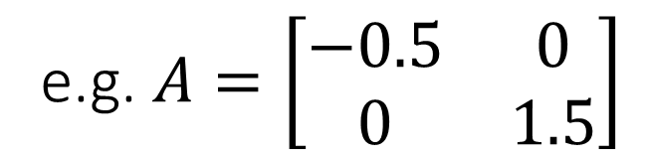
Special Linear Transformations
The first kind of linear transformations that we study are scaling transformations that simply scale the various dimensions by different amounts
Scaling by a negative quantity is permitted – amounts to flipping that dimension
For scaling transformations, output vector is of the same dim as input vector
Sometimes, we may treat scaling by zero as equivalent to dropping a dimension
Scaling transformations correspond to diagonal matrices
Easy to see that scaling maps are linear
e.g. $A=\left[\begin{matrix}−0.5 & 0 \\ 0 & 1.5\end{matrix}\right]$
Scale x axis by factor of 0.5 and flip it
Scale y axis by a factor of 1.5

Slide 15
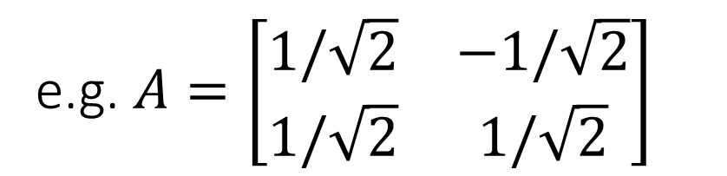
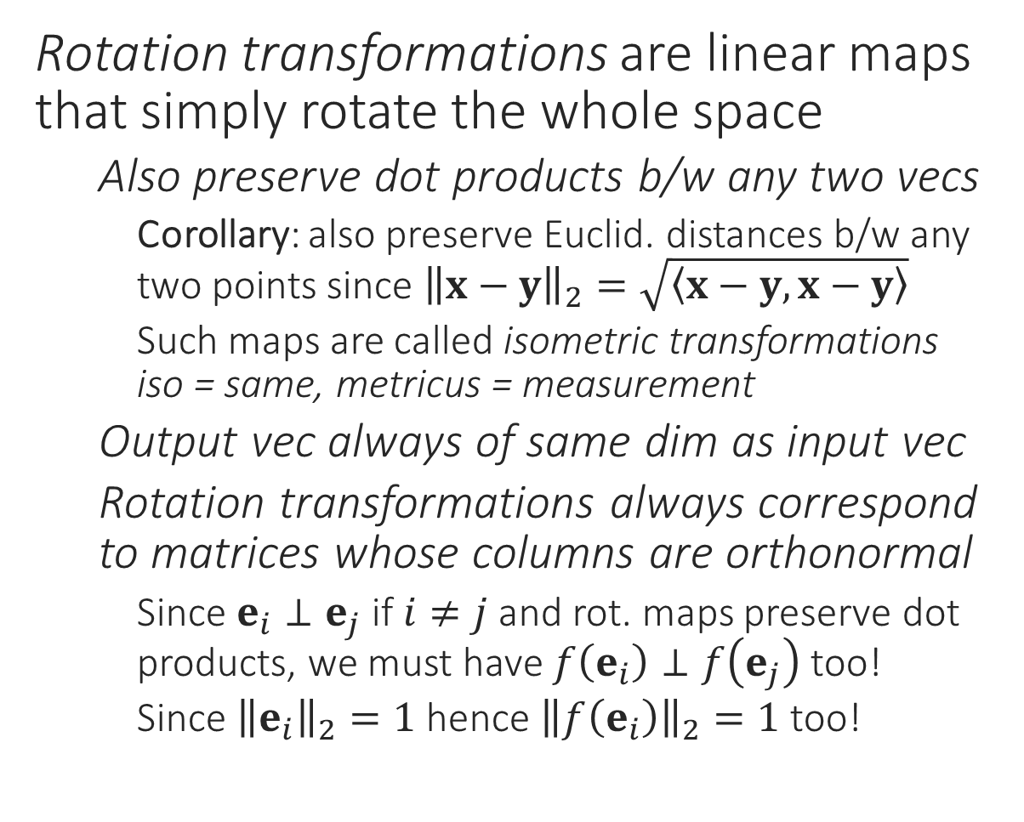
Special Linear Transformations
Caution: not all orthonormal matrices correspond to rotation maps though. Orthonormal matrices can also give maps that flip the sign of an axis (after rotating it) or even exchange axes
Rotation transformations are linear maps that simply rotate the whole space
Also preserve dot products b/w any two vecs
Corollary: also preserve Euclid. distances b/w any two points since ${\left\|x−y\right\|}_{2}=\sqrt{\left\langle x−y,x−y\right\rangle }$
Such maps are called isometric transformations iso = same, metricus = measurement
Output vec always of same dim as input vec
Rotation transformations always correspond to matrices whose columns are orthonormal
Since $e_{i}⊥e_{j}$ if $i≠j$ and rot. maps preserve dot products, we must have $f\left(e_{i}\right)⊥f\left(e_{j}\right)$ too!
Since ${\left\|e_{i}\right\|}_{2}=1$ hence ${\left\|f\left(e_{i}\right)\right\|}_{2}=1$ too!
e.g. $A=\left[\begin{matrix}1/\sqrt{2} & −1/\sqrt{2} \\ 1/\sqrt{2} & 1/\sqrt{2}\end{matrix}\right]$
Rotate counter-clockwise by 45 degrees

Slide 16
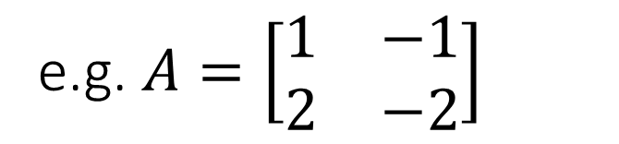
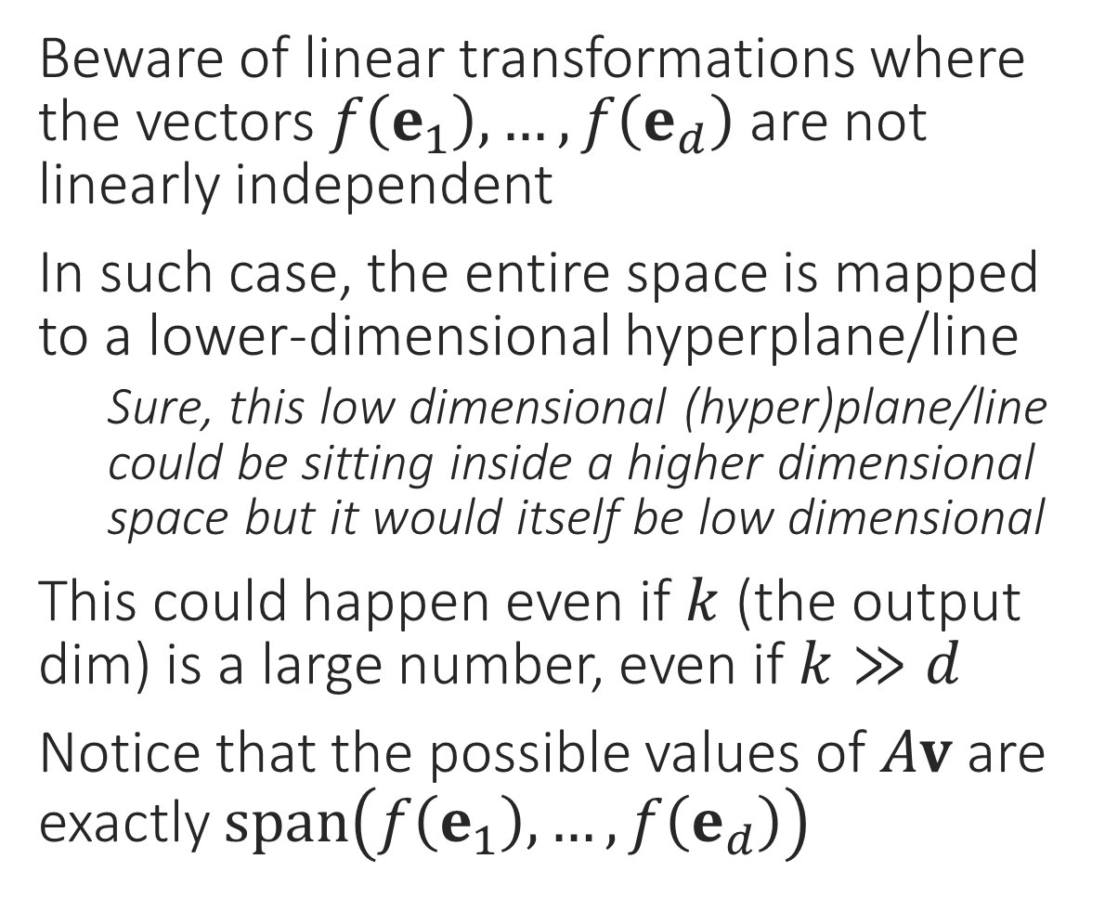
Special Linear Transformations
Beware of linear transformations where the vectors $f\left(e_{1}\right),…,f\left(e_{d}\right)$ are not linearly independent
In such case, the entire space is mapped to a lower-dimensional hyperplane/line
Sure, this low dimensional (hyper)plane/line could be sitting inside a higher dimensional space but it would itself be low dimensional
This could happen even if $k$ (the output dim) is a large number, even if $k≫d$
Notice that the possible values of $Av$ are exactly $span\left(f\left(e_{1}\right),…,f\left(e_{d}\right)\right)$
e.g. $A=\left[\begin{matrix}1 & −1 \\ 2 & −2\end{matrix}\right]$

Slide 17
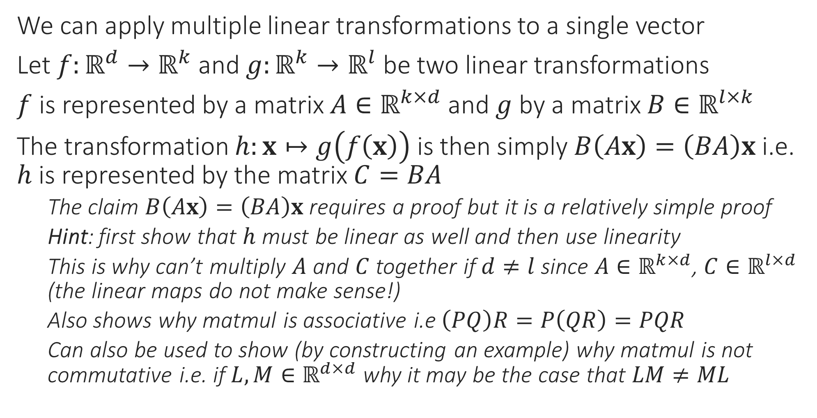
Applying Multiple Linear Transformations
We can apply multiple linear transformations to a single vector
Let $f:ℝ^{d}→ℝ^{k}$ and $g:ℝ^{k}→ℝ^{l}$ be two linear transformations
$f$ is represented by a matrix $A∈ℝ^{k×d}$ and $g$ by a matrix $B∈ℝ^{l×k}$
The transformation $h:x↦g\left(f\left(x\right)\right)$ is then simply $B\left(Ax\right)=\left(BA\right)x$ i.e. $h$ is represented by the matrix $C=BA$
The claim $B\left(Ax\right)=\left(BA\right)x$ requires a proof but it is a relatively simple proof
Hint: first show that $h$ must be linear as well and then use linearity
This is why can’t multiply $A$ and $C$ together if $d≠l$ since $A∈ℝ^{k×d}$, $C∈ℝ^{l×d}$ (the linear maps do not make sense!)
Also shows why matmul is associative i.e $\left(PQ\right)R=P\left(QR\right)=PQR$
Can also be used to show (by constructing an example) why matmul is not commutative i.e. if $L,M∈ℝ^{d×d}$ why it may be the case that $LM≠ML$

Slide 18
The Universal Linear Transformations
It turns out that scaling and rotation transformations are all we need to understand in order to understand any linear transformation
A superbly powerful result in linear algebra assures us that every linear transformation can be expressed as a composition of two rotation transformations and one scaling transformation
This result is known as the singular value decomposition (SVD) theorem and it underlies a very useful ML technique known as principal component analysis (PCA)

Slide 19


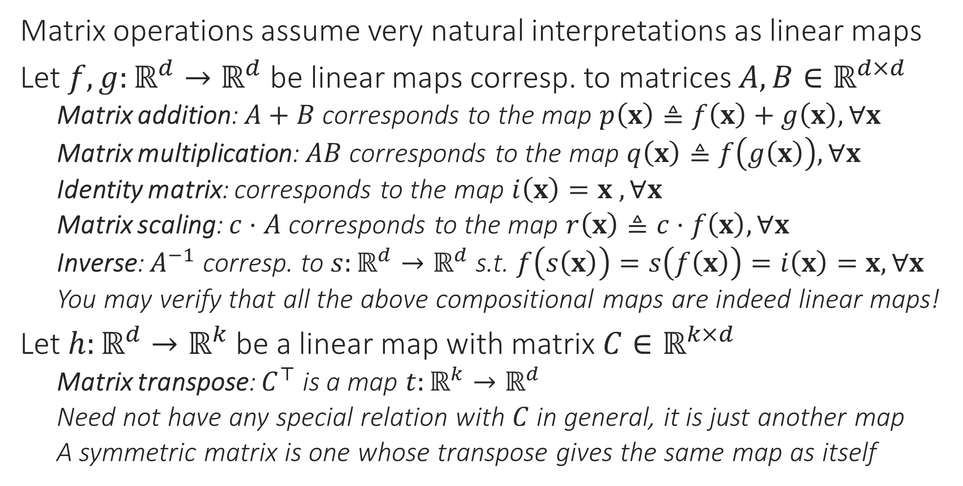
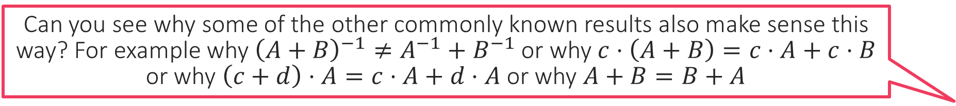

More on Compositional Linear Maps
Note that this makes the result ${\left(AB\right)}^{−1}=B^{−1}A^{−1}$ almost immediately intuitive. If we applied a map $g$ then a map $f$, then to invert/undo this composite map, we must first undo $f$ then undo $g$ ☺
Matrix operations assume very natural interpretations as linear maps
Let $f,g:ℝ^{d}→ℝ^{d}$ be linear maps corresp. to matrices $A,B∈ℝ^{d×d}$
Matrix addition: $A+B$ corresponds to the map $p\left(x\right)≜f\left(x\right)+g\left(x\right),∀x$
Matrix multiplication: $AB$ corresponds to the map $q\left(x\right)≜f\left(g\left(x\right)\right),∀x$
Identity matrix: corresponds to the map $i\left(x\right)=x$ $,∀x$
Matrix scaling: $c⋅A$ corresponds to the map $r\left(x\right)≜c⋅f\left(x\right),∀x$
Inverse: $A^{−1}$ corresp. to $s:ℝ^{d}→ℝ^{d}$ s.t. $f\left(s\left(x\right)\right)=s\left(f\left(x\right)\right)=i\left(x\right)=x,∀x$
You may verify that all the above compositional maps are indeed linear maps!
Let $h:ℝ^{d}→ℝ^{k}$ be a linear map with matrix $C∈ℝ^{k×d}$
Matrix transpose: $C^{⊤}$ is a map $t:ℝ^{k}→ℝ^{d}$
Need not have any special relation with $C$ in general, it is just another map
A symmetric matrix is one whose transpose gives the same map as itself
Can you see why some of the other commonly known results also make sense this way? For example why ${\left(A+B\right)}^{−1}≠A^{−1}+B^{−1}$ or why $c⋅\left(A+B\right)=c⋅A+c⋅B$ or why $\left(c+d\right)⋅A=c⋅A+d⋅A$ or why $A+B=B+A$

Slide 20
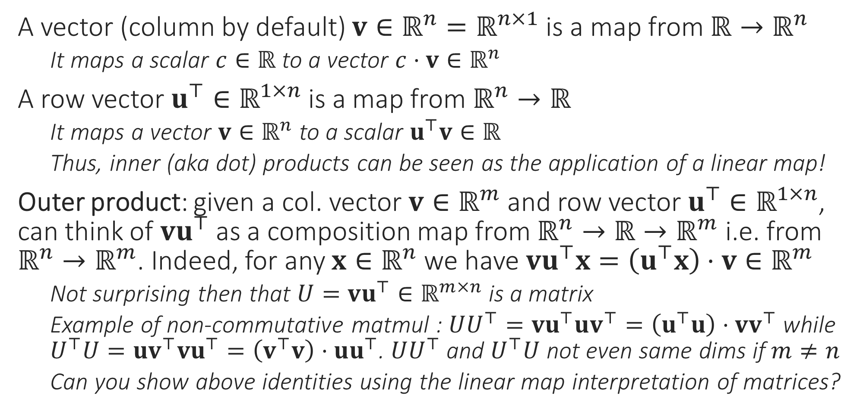
More on Compositional Linear Maps
A vector (column by default) $v∈ℝ^{n}=ℝ^{n×1}$ is a map from $ℝ→ℝ^{n}$
It maps a scalar $c∈ℝ$ to a vector $c⋅v∈ℝ^{n}$
A row vector $u^{⊤}∈ℝ^{1×n}$ is a map from $ℝ^{n}→ℝ$
It maps a vector $v∈ℝ^{n}$ to a scalar $u^{⊤}v∈ℝ$
Thus, inner (aka dot) products can be seen as the application of a linear map!
Outer product: given a col. vector $v∈ℝ^{m}$ and row vector $u^{⊤}∈ℝ^{1×n}$, can think of $vu^{⊤}$ as a composition map from $ℝ^{n}→ℝ→ℝ^{m}$ i.e. from $ℝ^{n}→ℝ^{m}$. Indeed, for any $x∈ℝ^{n}$ we have $vu^{⊤}x=\left(u^{⊤}x\right)⋅v∈ℝ^{m}$
Not surprising then that $U=vu^{⊤}∈ℝ^{m×n}$ is a matrix
Example of non-commutative matmul : $UU^{⊤}=vu^{⊤}uv^{⊤}=\left(u^{⊤}u\right)⋅vv^{⊤}$ while $U^{⊤}U=uv^{⊤}vu^{⊤}=\left(v^{⊤}v\right)⋅uu^{⊤}$. $UU^{⊤}$ and $U^{⊤}U$ not even same dims if $m≠n$
Can you show above identities using the linear map interpretation of matrices?

Slide 21
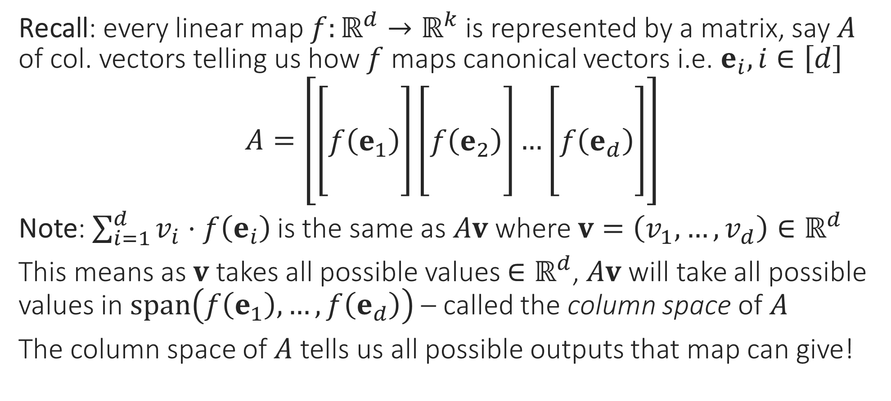
Column Space
Recall: every linear map $f:ℝ^{d}→ℝ^{k}$ is represented by a matrix, say $A$ of col. vectors telling us how $f$ maps canonical vectors i.e. $e_{i},i∈\left[d\right]$
$A=\left[\left[\begin{aligned} \\ f\left(e_{1}\right) \\ \end{aligned}\right]\left[\begin{aligned} \\ f\left(e_{2}\right) \\ \end{aligned}\right]…\left[\begin{aligned} \\ f\left(e_{d}\right) \\ \end{aligned}\right]\right]$
Note: $\sum_{i=1}^{d}{v_{i}⋅f\left(e_{i}\right)}$ is the same as $Av$ where $v=\left(v_{1},…,v_{d}\right)∈ℝ^{d}$
This means as $v$ takes all possible values $∈ℝ^{d}$, $Av$ will take all possible values in $span\left(f\left(e_{1}\right),…,f\left(e_{d}\right)\right)$ – called the column space of $A$
The column space of $A$ tells us all possible outputs that map can give!

Slide 22

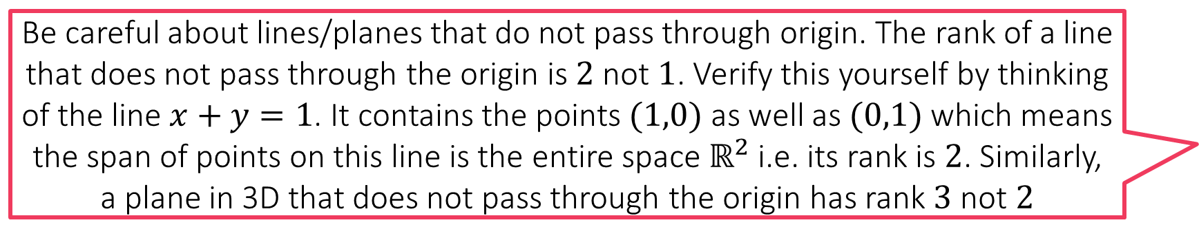

Rank
Can you see why we must always have $\dim\left(S\right)=\dim\left(span\left(S\right)\right)$?
Can you see why we must always have $\dim\left(S\right)≤\left|S\right|$?
Given a set of vectors $S$, the number of vectors in its basis is called the rank of the set $S$ – often written as $rank\left(S\right)$ or even $dim\left(S\right)$
Warning: a set of vectors can have more than one basis. However, all of them will have the same size. Gram-Schmidt will also give a basis of that same size
Special case 1: $dim\left(S\right)=0$. This can happen only if the set contains only one element (or many copies of it) and that element is the zero vector $0$
Special case 2: $dim\left(S\right)=1$. This happens when vectors in $S$ all lie along a line that passes through origin, even if the vectors are $d$-dimensional for $d>1$
Special case 3: $dim\left(S\right)=2$. This happens when vectors in $S$ all lie on a 2D plane passing through origin, even if the vectors are $d$-dimensional for $d>2$
Not so special case: $dim\left(S\right)=k$. This happens when vectors in $S$ are all $d$-dim vectors but all lie on a $k$-dimensional subspace of $ℝ^{d}$
For example, vectors in $ℝ^{5}$ lying on a 3-dimensional subspace
Be careful about lines/planes that do not pass through origin. The rank of a line that does not pass through the origin is $2$ not $1$. Verify this yourself by thinking of the line $x+y=1$. It contains the points $(1,0)$ as well as $(0,1)$ which means the span of points on this line is the entire space $ℝ^{2}$ i.e. its rank is $2$. Similarly, a plane in 3D that does not pass through the origin has rank $3$ not $2$

Slide 23
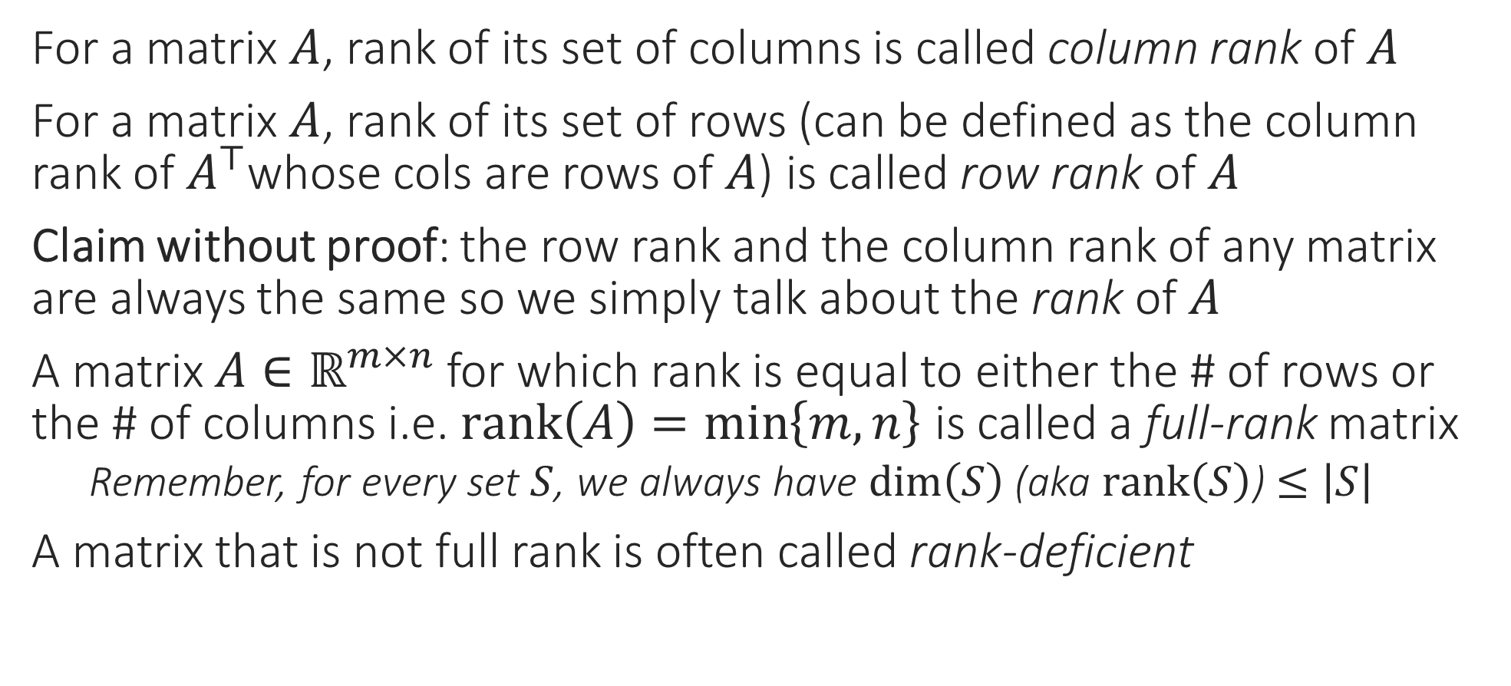
Column Rank
For a matrix $A$, rank of its set of columns is called column rank of $A$
For a matrix $A$, rank of its set of rows (can be defined as the column rank of $A^{⊤}$whose cols are rows of $A$) is called row rank of $A$
Claim without proof: the row rank and the column rank of any matrix are always the same so we simply talk about the rank of $A$
A matrix $A∈ℝ^{m×n}$ for which rank is equal to either the # of rows or the # of columns i.e. $rank\left(A\right)=\min\left\{m,n\right\}$ is called a full-rank matrix
Remember, for every set $S$, we always have $\dim\left(S\right)$ (aka $rank\left(S\right)$) $≤\left|S\right|$
A matrix that is not full rank is often called rank-deficient

Slide 24
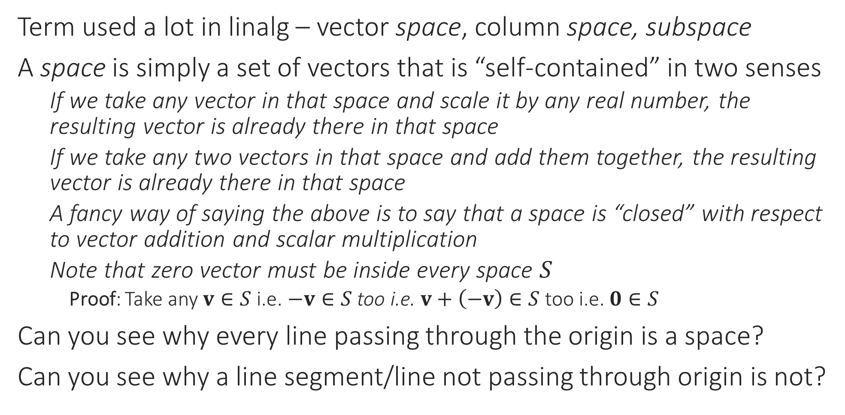
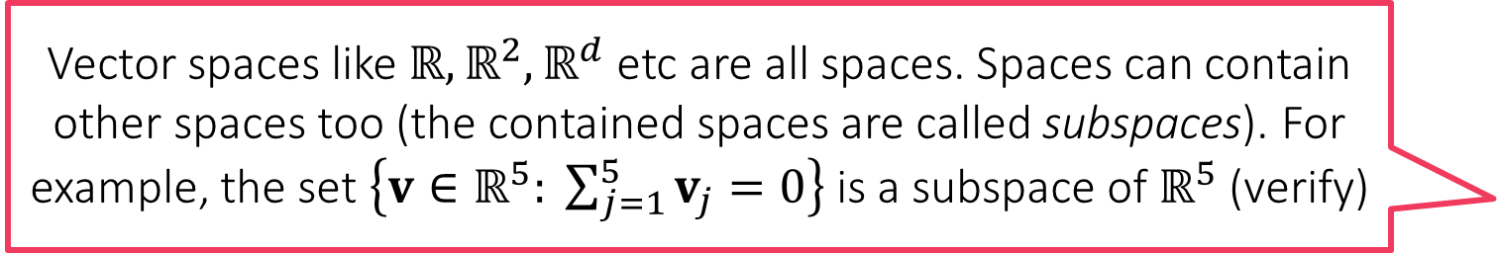
“Spaces”
Vector spaces like $ℝ,ℝ^{2},ℝ^{d}$ etc are all spaces. Spaces can contain other spaces too (the contained spaces are called subspaces). For example, the set $\left\{v∈ℝ^{5}: \sum_{j=1}^{5}{v_{j}}=0\right\}$ is a subspace of $ℝ^{5}$ (verify)
Term used a lot in linalg – vector space, column space, subspace
A space is simply a set of vectors that is “self-contained” in two senses
If we take any vector in that space and scale it by any real number, the resulting vector is already there in that space
If we take any two vectors in that space and add them together, the resulting vector is already there in that space
A fancy way of saying the above is to say that a space is “closed” with respect to vector addition and scalar multiplication
Note that zero vector must be inside every space $S$
Proof: Take any $v∈S$ i.e. $−v∈S$ too i.e. $v+\left(−v\right)∈S$ too i.e. $0∈S$
Can you see why every line passing through the origin is a space?
Can you see why a line segment/line not passing through origin is not?

Slide 25
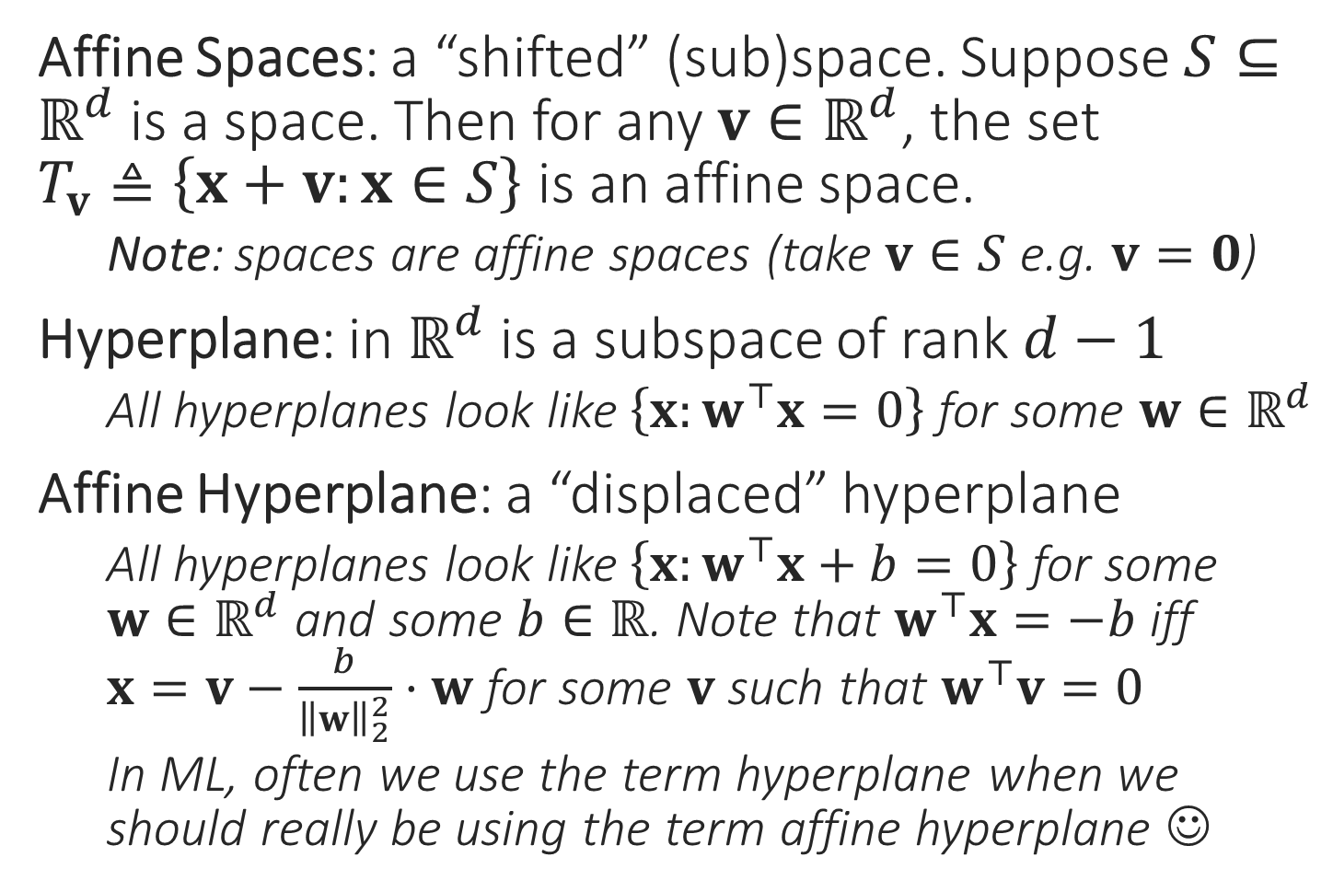
Terms Related to Spaces
Affine Spaces: a “shifted” (sub)space. Suppose $S⊆ℝ^{d}$ is a space. Then for any $v∈ℝ^{d}$, the set $T_{v}≜\left\{x+v:x∈S\right\}$ is an affine space.
Note: spaces are affine spaces (take $v∈S$ e.g. $v=0$)
Hyperplane: in $ℝ^{d}$ is a subspace of rank $d−1$
All hyperplanes look like $\left\{x:w^{⊤}x=0\right\}$ for some $w∈ℝ^{d}$
Affine Hyperplane: a “displaced” hyperplane
All hyperplanes look like $\left\{x:w^{⊤}x+b=0\right\}$ for some $w∈ℝ^{d}$ and some $b∈ℝ$. Note that $w^{⊤}x=−b$ iff $x=v−\frac{b}{{\left\|w\right\|}_{2}^{2}}⋅w$ for some $v$ such that $w^{⊤}v=0$
In ML, often we use the term hyperplane when we should really be using the term affine hyperplane ☺
Affine Space
Subspace
Affine Hyperplane
Hyperplane

Slide 26



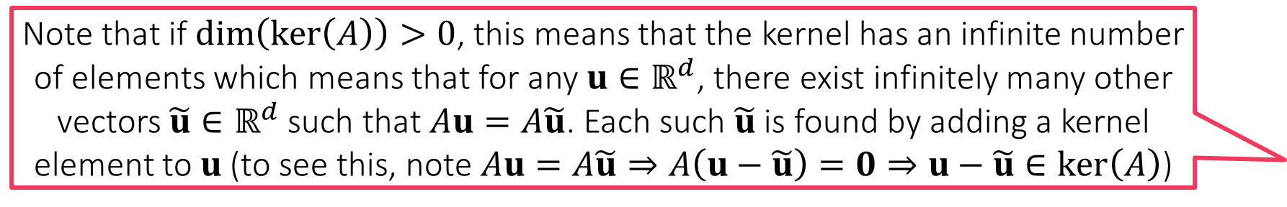
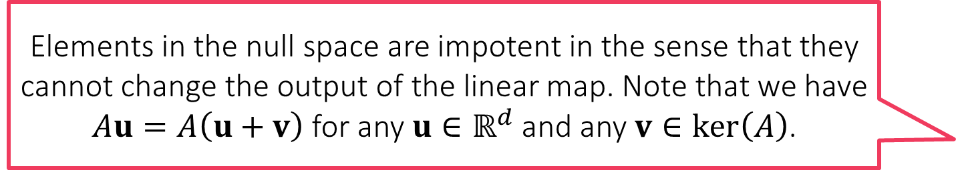
Null Space
Elements in the null space are impotent in the sense that they cannot change the output of the linear map. Note that we have $Au=A\left(u+v\right)$ for any $u∈ℝ^{d}$ and any $v∈\ker\left(A\right)$.
For any linear map $ℝ^{d}→ℝ^{k}$ with matrix $A∈ℝ^{k×d}$, its null space (aka kernel) is the set of inputs that get mapped to zero vector $\ker\left(A\right)=\{x∈ℝ^{d}:Ax=0\}$
Can you show that $\ker\left(A\right)$ is always a subspace of $ℝ^{d}$?
The rank/dimension of $\ker\left(A\right)$ is called the nullity of $A$
If $\dim\left(\ker\left(A\right)\right)=0$ then this means that $A$ only maps $0∈ℝ^{d}$to $0∈ℝ^{k}$
If $\dim\left(\ker\left(A\right)\right)=1$ then this means that $A$ maps an entire line passing through the origin (i.e. a subspace of dimension/rank 1) to $0$
If $\dim\left(\ker\left(A\right)\right)=2$ then this means that $A$ maps an entire 2D plane passing through the origin (i.e. a subspace of dimension/rank 2) to $0$ … etc etc
Rank-Nullity Theorem: $\dim\left(\ker\left(A\right)\right)+\operatorname{rank}\left(A\right)=d$
This implies that a matrix with nullity zero will always be full rank!
Note that if $\dim\left(\ker\left(A\right)\right)>0$, this means that the kernel has an infinite number of elements which means that for any $u∈ℝ^{d}$, there exist infinitely many other vectors $\tilde{u}∈ℝ^{d}$ such that $Au=A\tilde{u}$. Each such $\tilde{u}$ is found by adding a kernel element to $u$ (to see this, note $Au=A\tilde{u}⇒A\left(u−\tilde{u}\right)=0⇒u−\tilde{u}∈\ker\left(A\right)$)

Slide 27
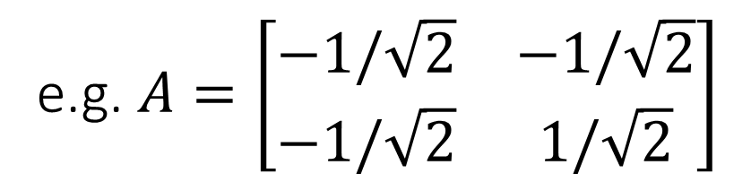
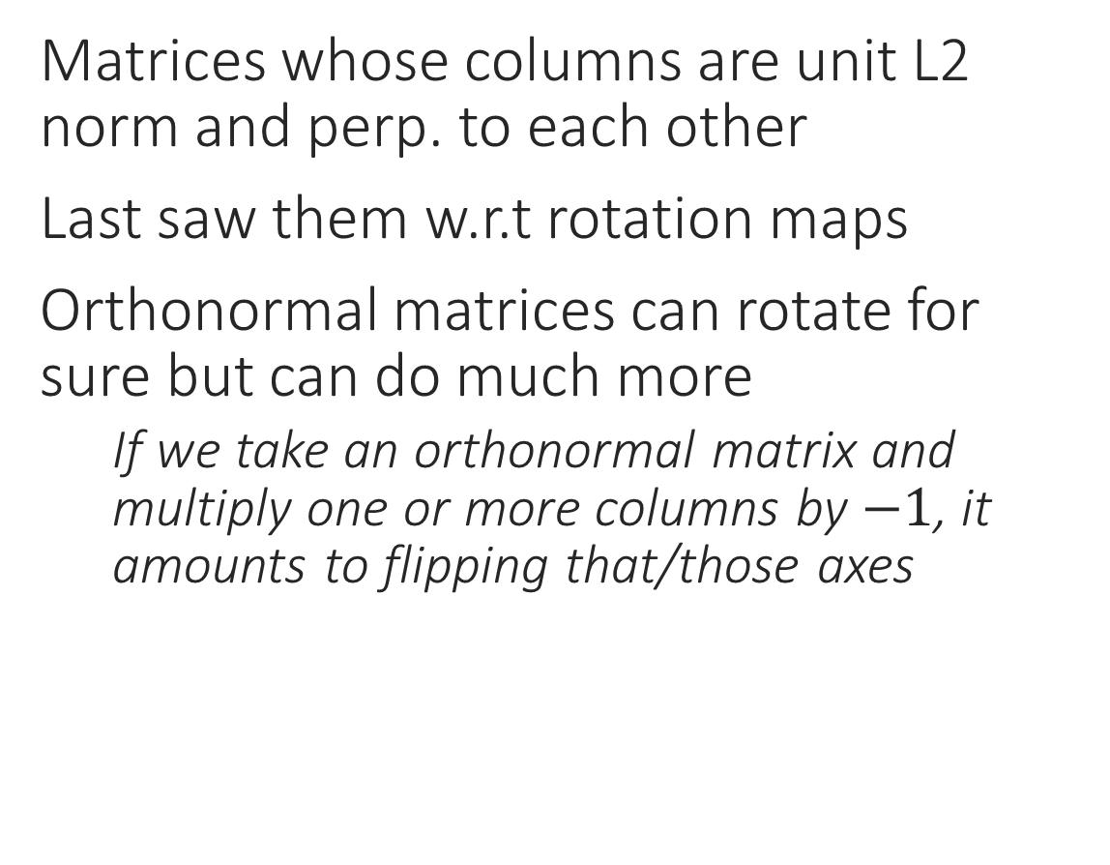
Orthonormal Matrices
Matrices whose columns are unit L2 norm and perp. to each other
Last saw them w.r.t rotation maps
Orthonormal matrices can rotate for sure but can do much more
If we take an orthonormal matrix and multiply one or more columns by $−1$, it amounts to flipping that/those axes
e.g. $A=\left[\begin{matrix}−1/\sqrt{2} & −1/\sqrt{2} \\ −1/\sqrt{2} & 1/\sqrt{2}\end{matrix}\right]$

Slide 28
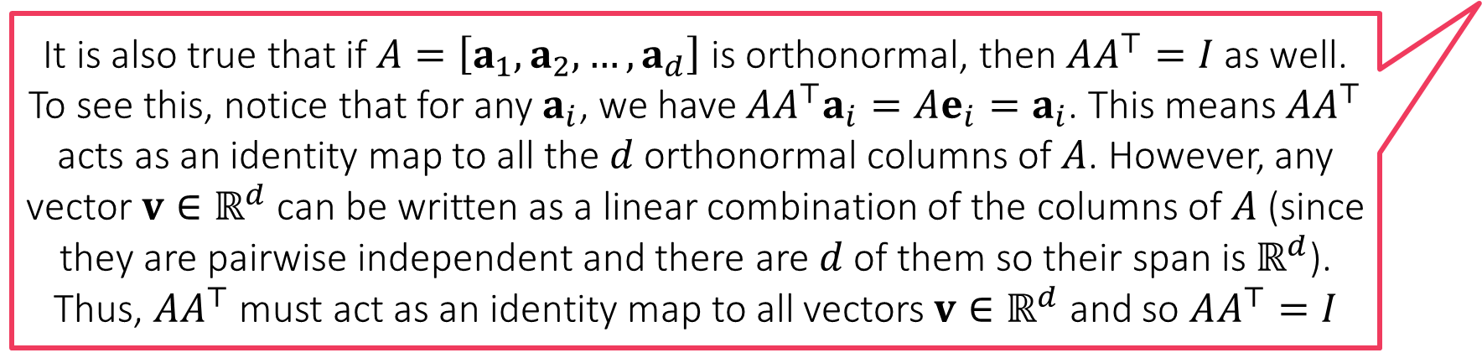
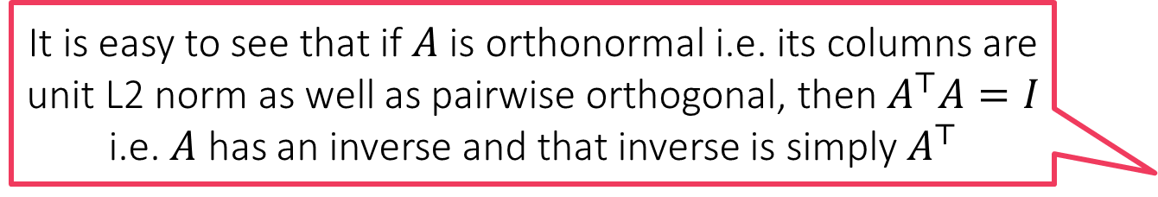

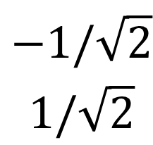

Orthonormal Matrices
It is easy to see that if $A$ is orthonormal i.e. its columns are unit L2 norm as well as pairwise orthogonal, then $A^{⊤}A=I$ i.e. $A$ has an inverse and that inverse is simply $A^{⊤}$
Matrices whose columns are unit L2 norm and perp. to each other
Last saw them w.r.t rotation maps
Orthonormal matrices can rotate for sure but can do much more
If we take an orthonormal matrix and multiply one or more columns by $−1$, it amounts to flipping that/those axes
If we take an orthonormal matrix and shift its columns around, it amounts to exchanging/reordering those axes
In general, orthonormal matrices give us a new (rotated/flipped/exchanged) basis
It is also true that if $A=\left[a_{1},a_{2},…,a_{d}\right]$ is orthonormal, then $AA^{⊤}=I$ as well. To see this, notice that for any $a_{i}$, we have $AA^{⊤}a_{i}=Ae_{i}=a_{i}$. This means $AA^{⊤}$ acts as an identity map to all the $d$ orthonormal columns of $A$. However, any vector $v∈ℝ^{d}$ can be written as a linear combination of the columns of $A$ (since they are pairwise independent and there are $d$ of them so their span is $ℝ^{d}$). Thus, $AA^{⊤}$ must act as an identity map to all vectors $v∈ℝ^{d}$ and so $AA^{⊤}=I$
$$\begin{matrix}1/\sqrt{2} \\ 1/\sqrt{2}\end{matrix}$$
$$\begin{matrix}−1/\sqrt{2} \\ 1/\sqrt{2}\end{matrix}$$
e.g. $A=\left[\begin{matrix}1/\sqrt{2} & −1/\sqrt{2} \\ 1/\sqrt{2} & 1/\sqrt{2}\end{matrix}\right]$

